Slide 1
UNIVERSITY INSTITUTE OF ENGINEERING
COMPUTER SCIENCE ENGINEERING
Master of Engineering
ADVANCED DATA STRUCTURES
&
ALGORITHMS
(23CSH-622)
By : Dr. Ranjit Singh (E10947)
INTRODUCTION
DISCOVER . LEARN . EMPOWER

Slide 2
Contents of the Syllabus
UNIT-I (15h)
Introduction to Basic Data Structures: Importance and need of good data structures and algorithms, Introduction to linear and non-linear data structure and its importance, Algorithms Complexity and Analysis. [3]
Linear and Non –Linear Data Structures : Arrays , Link Lists, Queues , Trees and related algorithms [6]
Advanced Data Structures: AVL Trees (Insertion , Deletion , Searching), Red-Black Trees, B-trees, B+trees, Heaps. Data structure for disjoint sets, Augmented data structures. [6]
UNIT-II (15h)
Searching and Sorting : Internal and External Sorting algorithms: Linear Search, Binary Search, Bubble Sort, Selection Sort, Insertion Sort, Shell Sort, Quick Sort, Heap Sort, Merge Sort, Counting Sort, Radix Sort and analysis of their complexities and Hashing [4]
Graphs & Algorithms: Representation, Type of Graphs, Depth- and breadth-first traversals, Planar graphs, isomorphism, graph coloring, covering and partition, Minimum Spanning Tree: Prim’s and Kruskal’s algorithms. [6]
String Matching Algorithms: Naïve String Matching, Suffix arrays, Suffix trees, Rabin-Karp, Knuth-Morris-Pratt, Booyer-Moore algorithm [5]

Slide 3
Contents of the Syllabus
UNIT-III (15h)
Approximation algorithms: Need of approximation algorithms: Introduction to P, NP, NP-Hard and NP-Complete Greedy Approach, Dynamic Approach, Knapsack, Huffman Coding, TSP, All pair shortest path, Longest Common Subsequence Problem, Matrix Chain Multiplication. [7]
Randomized algorithms: Introduction, type of randomized algorithms, Quick sort, min cut [4]
Online Algorithms: Introduction, Online Paging Problem, k-server Problem. Data compression: Huffman’s coding, BWT, LZW [4]
Recommended Books:
1. Cormen, Leiserson, Rivest, Stein, “Introduction to Algorithms”, Prentice Hall of India, 3rd edition 2012.
2. Horowitz, Sahni and Rajasekaran, “Fundamental of Computer, Algorithms”, University Press (India), 2nd edition.
3. Aho, Haperoft and Ullman, “The Design and analysis of Computer Algorithms”, Pearson Education India.

Slide 4
Introduction
Graphs (sometimes referred to as networks) offer a way of expressing relationships between pairs of items, and are one of the most important abstractions in the study of algorithms.
Graphs can be very important in modelling data.
Furthermore a large number of problems can be reduced to known graph problems.
A graph consists of a set of vertices with connections between them.

Slide 5
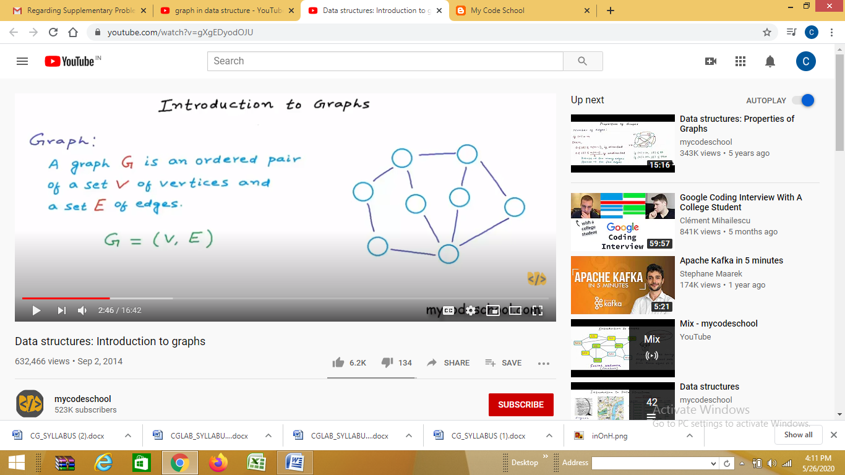
Graph

Slide 6
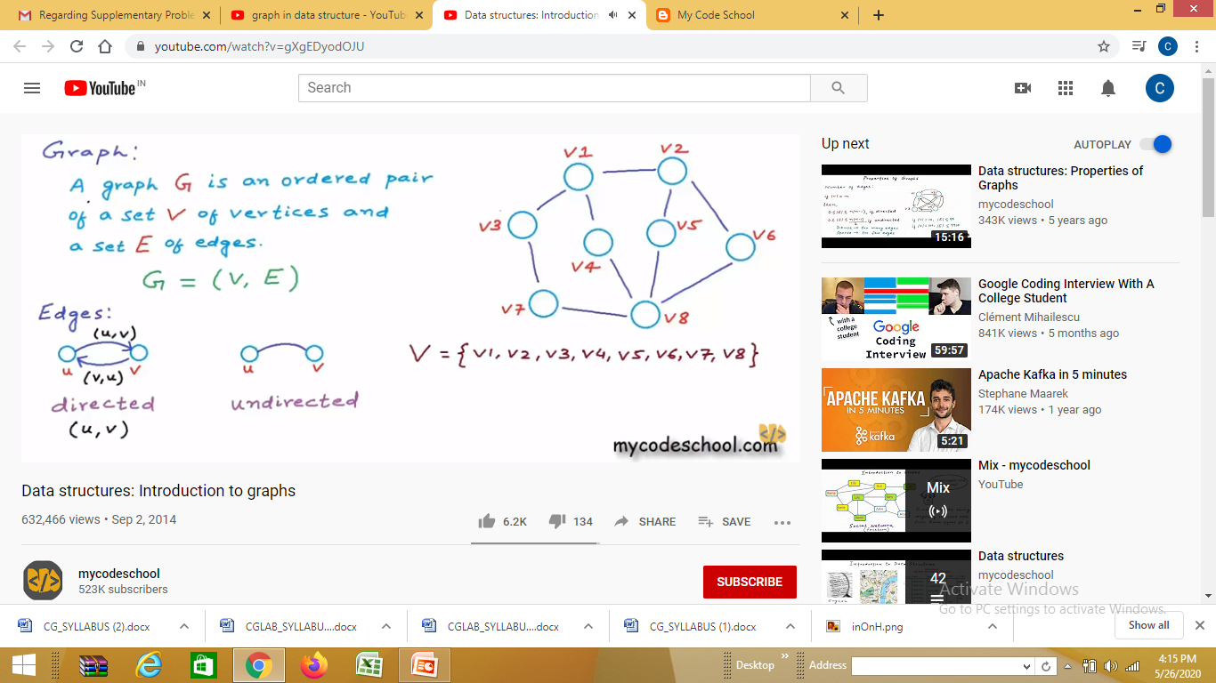
Graph

Slide 7
Graphs are used to solve many real-life problems. Graphs are used to represent networks.
The networks may include paths in a city or telephone network or circuit network.
Graphs are also used in social networks like linkedIn, Facebook.
For example, in Facebook, each person is represented with a vertex(or node). Each node is a structure and contains information like person id, name, gender, locale etc.

Slide 8
GRAPHS- APPLICATIONS
Social network graphs: to tweet or not to tweet. Graphs that represent who knows whom, who communicates with whom, who Influences whom or other relationships in social structures.
An example is the twitter graph of who follows whom. These can be used to determine how information flows, how topics become hot, how communities develop, or even who might be a good match for who, or is that whom.
Utility graphs: The power grid, the Internet, and the water network are all examples of graphs where vertices represent connection points, and edges the wires or pipes between them.
Analysing properties of these graphs is very important in understanding the reliability of such utilities under failure or attack, or in minimizing the costs to build infrastructure that matches required demands.

Slide 9
GRAPHS- APPLICATIONS
Transportation networks: In road networks vertices are intersections and edges are the road segments between them, and for public transportation networks vertices are stops and edges are the links between them. Such networks are used by many map programs such as google maps, Bing maps and now Apple IOS 6 maps (well perhaps without the public transport) to find the best routes between location.
Protein-protein interactions graphs: Vertices represent proteins and edges represent interactions between them that carry out some biological function in the cell. These graphs can be used, for example, to study molecular pathways—chains of molecular interactions in a cellular process.

Slide 10
GRAPHS- APPLICATIONS
Network packet traffic graphs. Vertices are IP (Internet protocol) addresses and edges are the packets that flow between them. Such graphs are used for analysing network security, studying the spread of worms, and tracking criminal or non-criminal activity.
Scene graphs: In graphics and computer games scene graphs represent the logical or special relationships between objects in a scene. Such graphs are very important in the computer games industry.
Graphs in compilers: Graphs are used extensively in compilers. They can be used for type inference, for so called data flow analysis, register allocation and many other purposes. They are also used in specialized compilers, such as query optimization in database languages.

Slide 11
GRAPHS TERMINOLOGY
Before starting with graph operations, let’s first have a look at graph terminology [3]:
Vertex
Edge
Graph
Undirected graph
Directed graph
Degree of vertex
Number of vertices adjacent to vertex v.
Pendent vertex
A vertex with degree one
Isolated vertex
A vertex with degree zero
Adjacency
Adjacent vertices
Adjacent edges

Slide 12
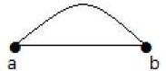
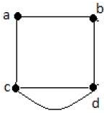
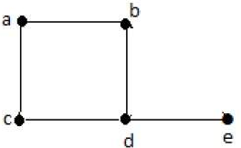
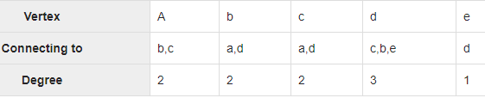
GRAPHS TERMINOLOGY
Parallel edges
if a pair of vertices is connected by more than one edge, then those edges are called parallel edges.
Multi graph
A graph having parallel edges is known as a Multigraph.
Degree sequence of graph
If the degrees of all vertices in a graph are arranged in descending or ascending order, then the sequence obtained is known as the degree sequence of the graph.

Slide 13
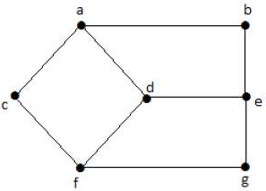
GRAPHS TERMINOLOGY
Distance between two vertices
shortest path between Vertex U and Vertex V
Eccentricity of a Vertex
The maximum distance between a vertex to all other vertices
Radius of a Connected Graph
The minimum eccentricity from all the vertices is considered as the radius of the Graph G
Diameter of a Graph
The maximum eccentricity from all the vertices is considered as the diameter of the Graph G. Example: In above graph, maximum e is 3.
e(a) =3, e(b) = 3, e(c) = 3
e(d) = 2, e(e) = 3
e(f) = 3, e(g) = 3

Slide 14
GRAPHS- REPRESENTATION
Edge list
Adjacency Matric
Adjacency List

Slide 15
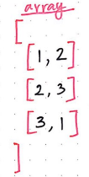
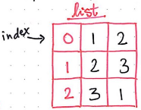
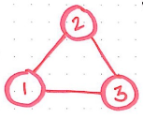
GRAPHS- REPRESENTATION
Edge List:
A list of pairs (i, j) ∈ E in a graph.
Edge lists (or array) is one of the simplest representations of graph.
To represent a graph with 3 nodes (1,2 and 3), we could either use a list format or an array to represent the graph as an edge list.

Slide 16
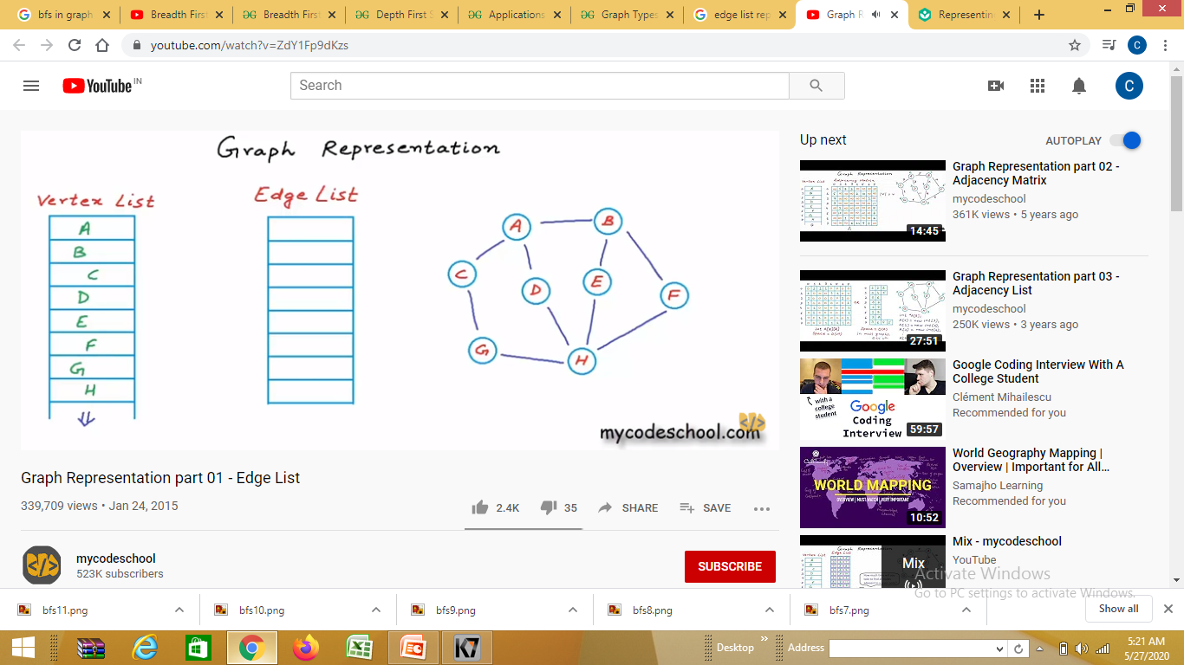
EDGE LIST

Slide 17
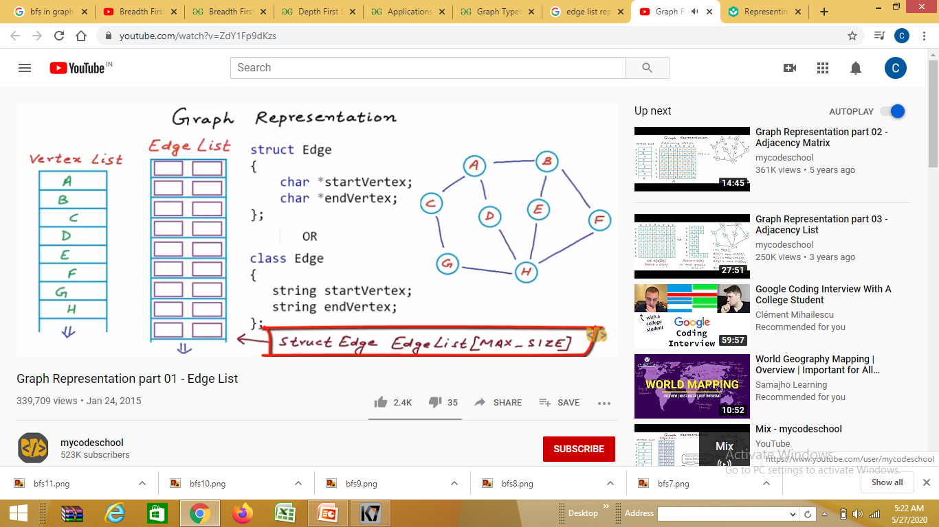
EDGE LIST

Slide 18
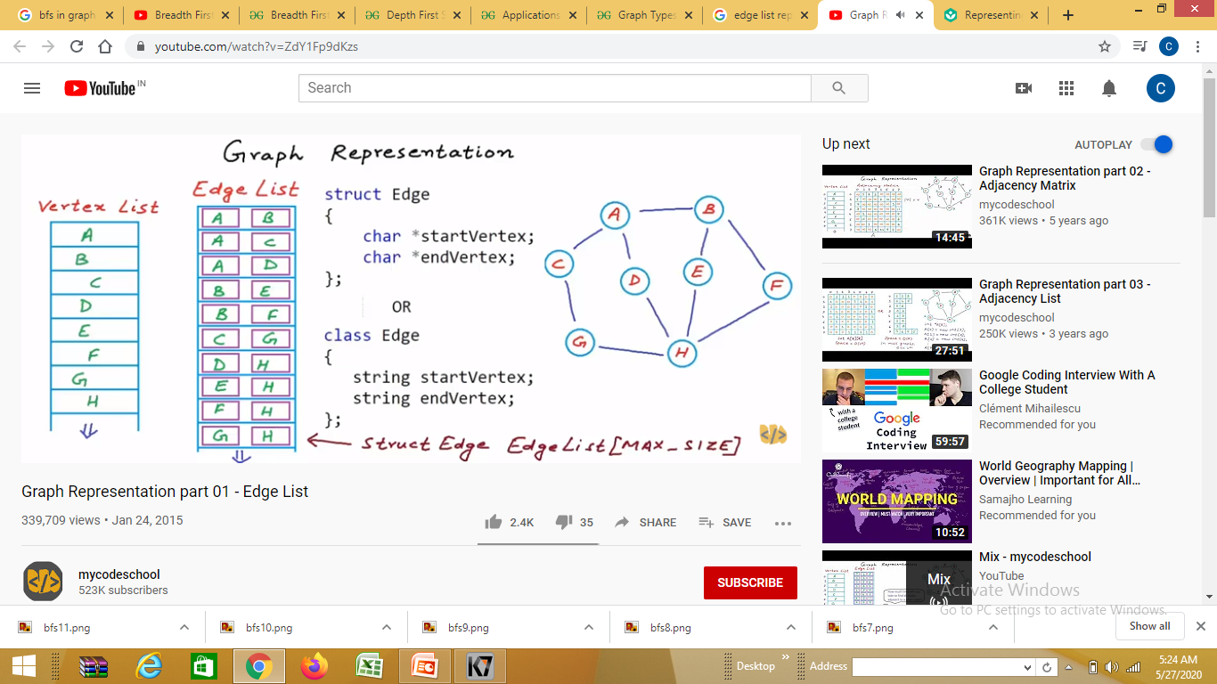
EDGE LIST

Slide 19
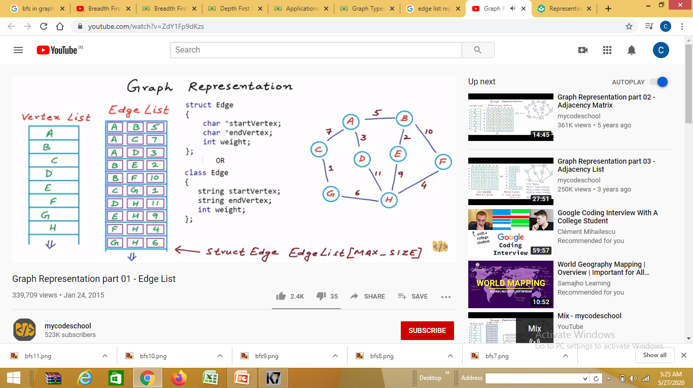
For weighted Graph

Slide 20
GRAPHS- REPRESENTATION
Edge List:
This list (or array) is called an edge list, and is a representation of all the edges (|E|) in the graph.
In the example shown here, we have a small graph, with just three nodes: 1, 2, and 3. Each edge is given an index, and represents a reference from one node to another.
We’ll notice that there isn’t any particular order to the edges as they appear in the edge list, but every single edge must be represented.

Slide 21
GRAPHS- REPRESENTATION
Edge List:
Because an edge list is really just an array, the only way to find something in this array is by iterating through it.
For example, if we wanted to see if vertex 1 was connected to vertex 2, we’d need to iterate through this array and look for the existence of a pair [1, 2] or [2, 1].
Now, this is fine for our graph, which only has three vertices and three edges; iterating through this array isn’t really a big deal.
But realistically speaking, most graphs are going to be much bigger than this one! So, here the best option would be to use adjacency matrix.

Slide 22
GRAPHS- REPRESENTATION
Adjacency matrix:
For most graphs, an edge list won’t end up being the most efficient choice. So, we can go from a list to a matrix — an adjacency matrix, that is!
An adjacency matrix is a matrix representation of exactly which nodes in a graph contain edges between them. The matrix is kind of like a lookup table: once we’ve determined the two nodes that we want to find an edge between, we look at the value at the intersection of those two nodes

Slide 23
GRAPHS- REPRESENTATION
Adjacency matrix:
An n × n matrix of binary values in which location (i, j) is 1 if (i, j) ∈ E and 0 otherwise. Note that for an undirected graph the matrix is symmetric and 0 along the diagonal.
An adjacency matrix is 2D array of V x V vertices. Each row and column represent a vertex.
If the value of any element a[i][j] is 1, it represents that there is an edge connecting vertex i and vertex j.

Slide 24
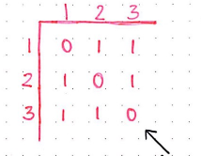
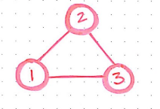
GRAPHS- REPRESENTATION
Adjacency matrix:
Example:
If the values on both sides of
the diagonal are same, matrix
is said to be symmetric.
Adjacency matrices always
have a main diagonal, which
Will be all 0’s for simple graphs
As we don’t usually have self-
Referential edges.
Undirected Graph
Adjacency Matrix

Slide 25
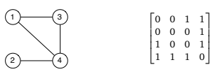
GRAPHS- REPRESENTATION
Adjacency matrix:
Adjacency Matrix for a given graph
Since it is an undirected graph, for edge (1,4), we also need to mark edge (4,1); making the adjacency matrix symmetric about the diagonal.
Edge lookup(checking if an edge exists between vertex A and vertex B) is extremely fast in adjacency matrix representation but we have to reserve space for every possible link between all vertices(V x V), so it requires more space.

Slide 26
GRAPHS- REPRESENTATION
Trouble with adjacency matrix:
They are easy to follow and represent, and looking up, inserting, removing an edge can be done in O(1) or constant time.
However, they can take-up more space than is really necessary. An adjacency matrix always consume O(v²) amount of space.
If a graph has few edges and is sparse, the matrix will be mostly filled with 0’s, but takes-up lots of space.
So, as great as an adjacency matrix can be, it isn’t always the right representation for a graph (particularly if that graph is sparse).

Slide 27
GRAPHS- REPRESENTATION
Adjacency list:
When both edge lists and adjacency matrices seem to fail, the best choice would be to combine them both together. And that’s exactly what an adjacency list is — a hybrid between an edge list and an adjacency matrix.
An adjacency list is an array of linked lists that serves as a representation of a graph, but also makes it easy to see which other vertices are adjacent to other vertices.
An adjacency list is the most popular and commonly-used representation of a graph since most graph traversal problems require us being able to easily figure out which nodes are the neighbours of another node

Slide 28
GRAPHS- REPRESENTATION
Adjacency list:
An array A of length n where each entry A[i] contains a pointer to a linked list of all the out-neighbours of vertex i. In an undirected graph with edge {u, v} the edge will appear in the adjacency list for both u and v.

Slide 29
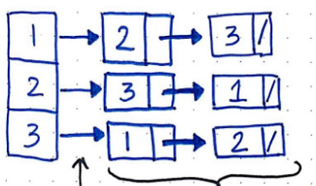
GRAPHS- REPRESENTATION
Adjacency list:
An adjacency list represents a graph as an array of linked list.
The index of the array represents a vertex and each element in its linked list represents the other vertices that form an edge with the vertex.
Another example:
Undirected Graph
vertex
Pointer to an
array or linked list
Linked list of neighbouring
vertices to the vertex 3

Slide 30
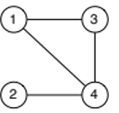
GRAPHS- REPRESENTATION
Adjacency list:
The adjacency list for the given graph is as follows:

Slide 31
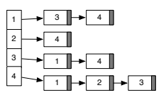
GRAPHS- REPRESENTATION
Adjacency list:
The adjacency list for the given graph is as follows:

Slide 32
GRAPHS- REPRESENTATION
Adjacency list:
In the illustration drawn here, each vertex is given an index in its list, and has all of its neighbouring vertices stored as an linked list (which could also be an array), adjacent to it.
For example, the last element in the list is the vertex 3, which has pointer to a linked list of its neighbours.
The linked list that is adjacent to vertex 3 contains references to two other vertices: 1 and 2, which are the two nodes that are connected to the node 3.
Thus, just by looking up the node 3, we can determine who it’s neighbours are and, quickly identify that it has two edges connected to it.

Slide 33
GRAPHS- OPERATIONS
There are several operations which can be performed on data structures, but for graph we are listing the common ones:
Traversing a graph
Concepts related to graph traversal include:
Euler’s Path
Euler’s Circuit
Hamiltonian cycle
Hamiltonian path
Searching a graph
BFS
DFS
Expand the shallowest unexpanded (unmarked) node.
Implementation: queue.
Expand the deepest unexpanded (unmarked) node.
Implementation: stack or recursion.

Slide 34
BFS (https://www.geeksforgeeks.org/breadth-first-search-or-bfs-for-a-graph/)
Breadth-first search (BFS) is an algorithm that is used to graph data or searching tree or traversing structures.
The algorithm efficiently visits and marks all the key nodes in a graph in an accurate breadthwise fashion. This algorithm selects a single node (initial or source point) in a graph and then visits all the nodes adjacent to the selected node. Remember, BFS accesses these nodes one by one.
Once the algorithm visits and marks the starting node, then it moves towards the nearest unvisited nodes and analyses them. Once visited, all nodes are marked. These iterations continue until all the nodes of the graph have been successfully visited and marked.

Slide 35
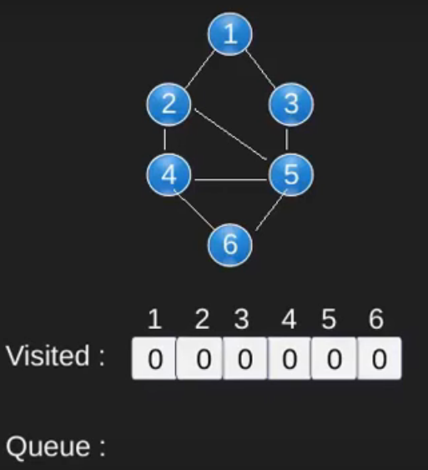
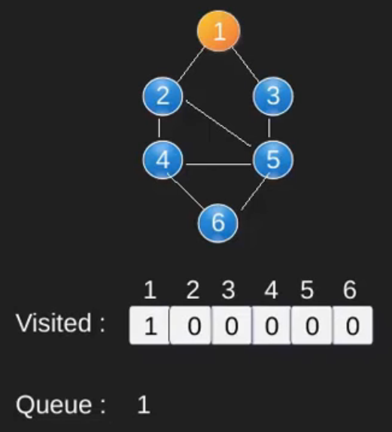
BFS

Slide 36
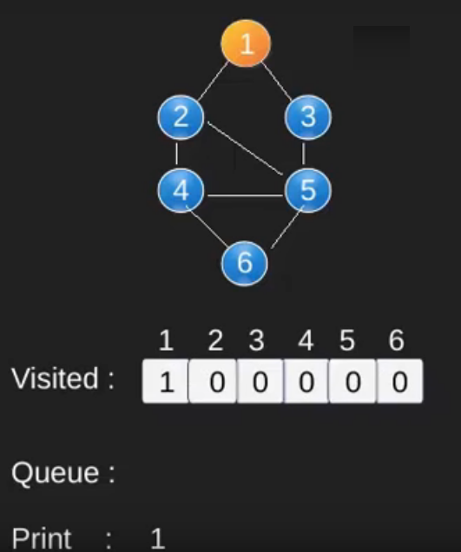
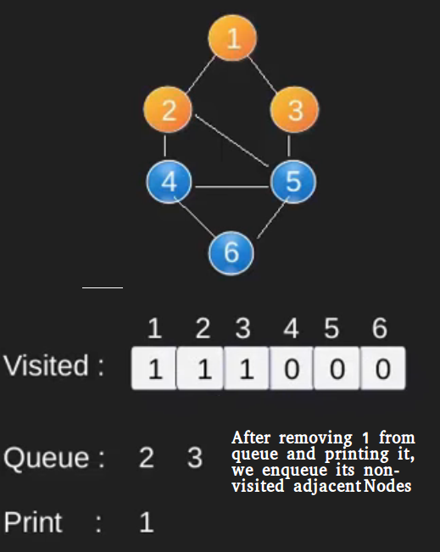
BFS

Slide 37
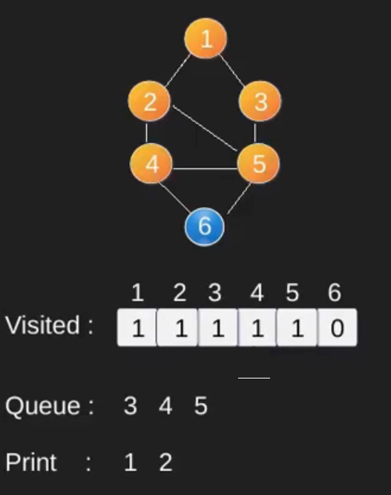
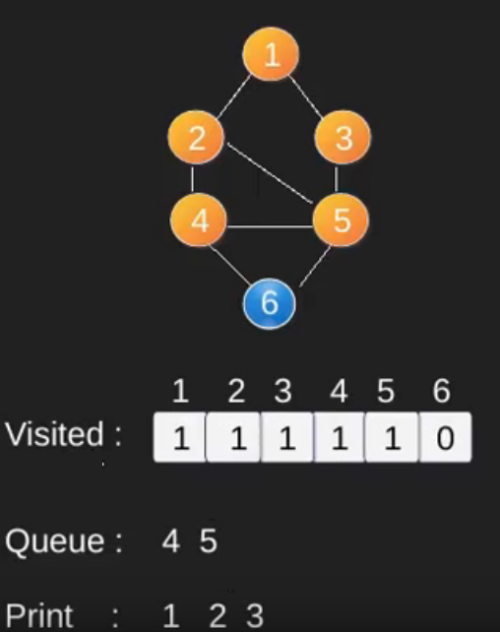
BFS

Slide 38
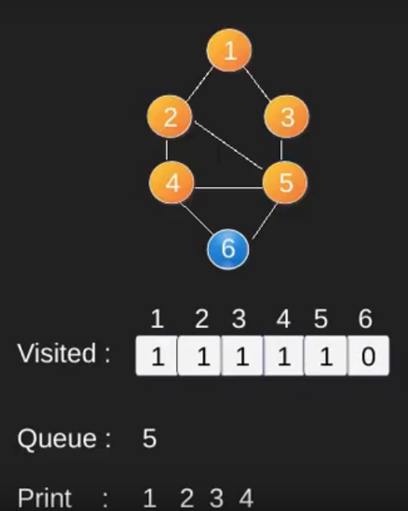
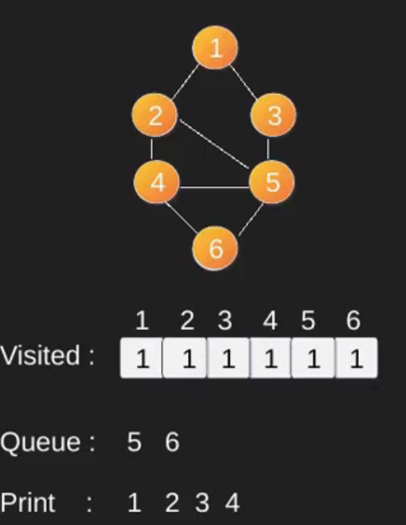
BFS

Slide 39
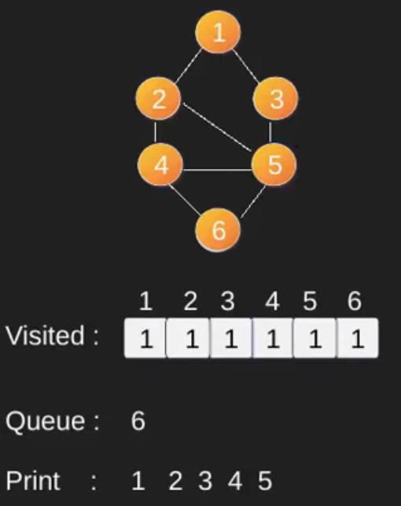
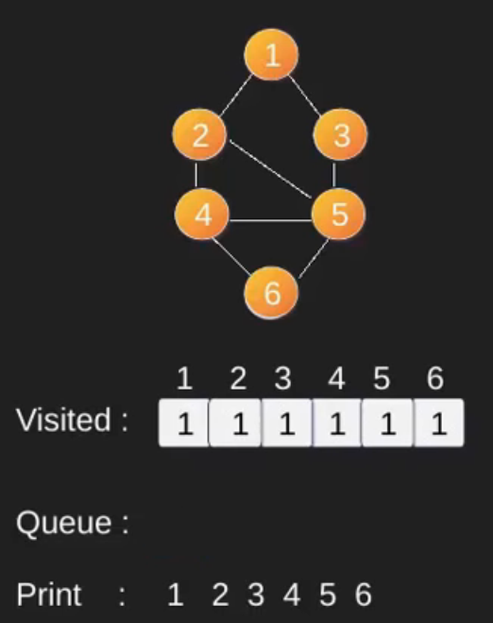
BFS

Slide 40
DFS
Approach: Depth-first search is an algorithm for traversing or searching tree or graph data structures. The algorithm starts at the root node (selecting some arbitrary node as the root node in the case of a graph) and explores as far as possible along each branch before backtracking. So the basic idea is to start from the root or any arbitrary node and mark the node and move to the adjacent unmarked node and continue this loop until there is no unmarked adjacent node. Then backtrack and check for other unmarked nodes and traverse them. Finally print the nodes in the path.
Algorithm:
Create a recursive function that takes the index of node and a visited array.
Mark the current node as visited and print the node.
Traverse all the adjacent and unmarked nodes and call the recursive function with index of adjacent node.

Slide 41
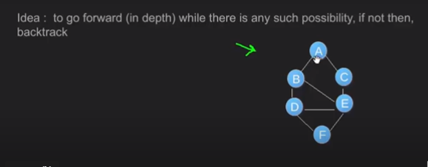
DFS

Slide 42
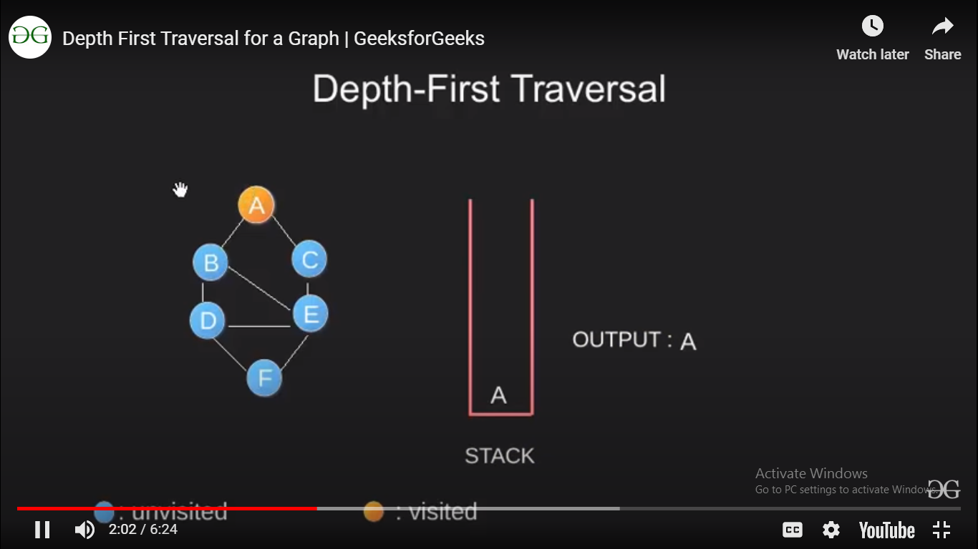
DFS

Slide 43
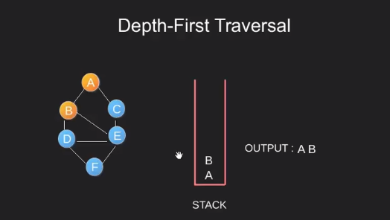
DFS

Slide 44
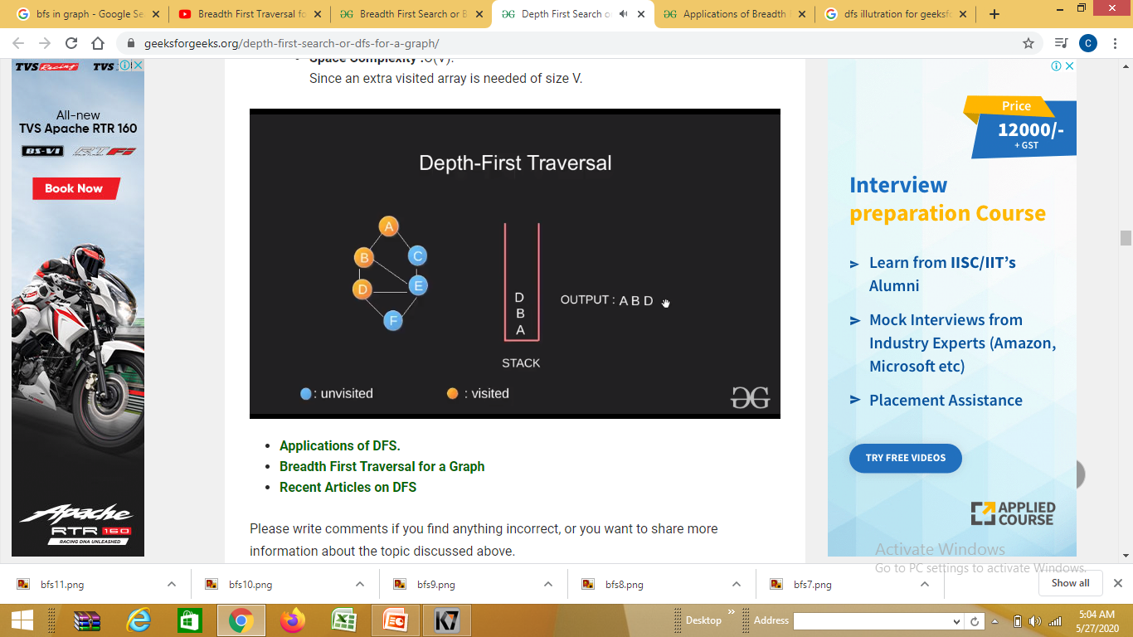
DFS

Slide 45

DFS

Slide 46
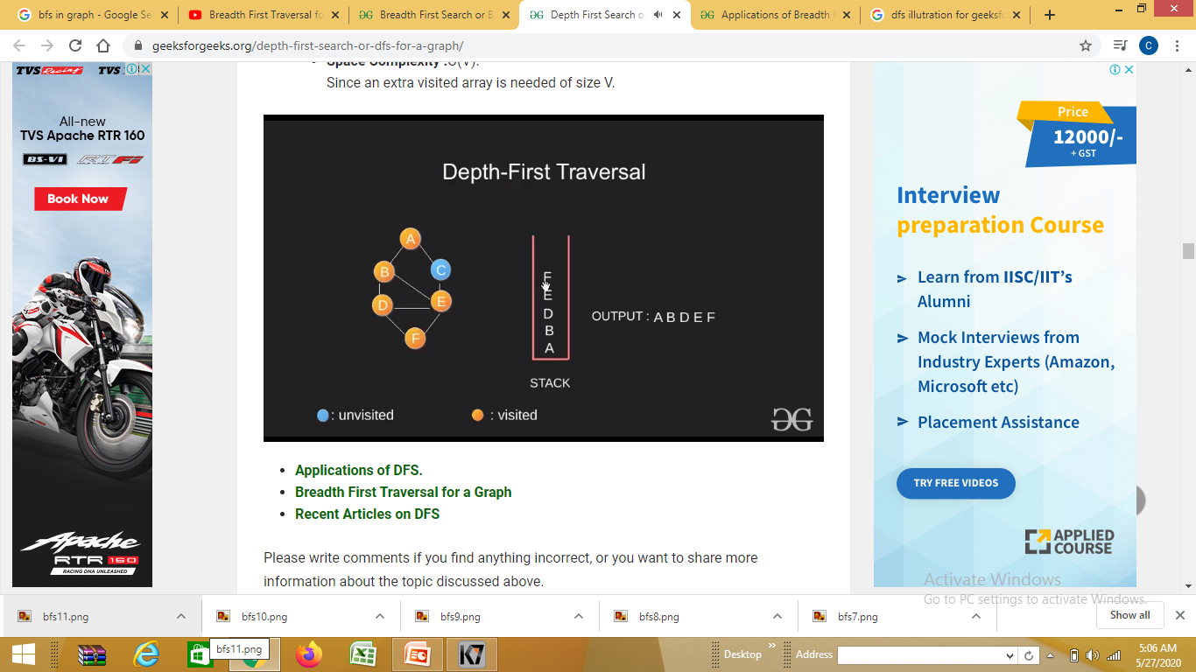
DFS

Slide 47

DFS

Slide 48

DFS

Slide 49

DFS

Slide 50

DFS

Slide 51
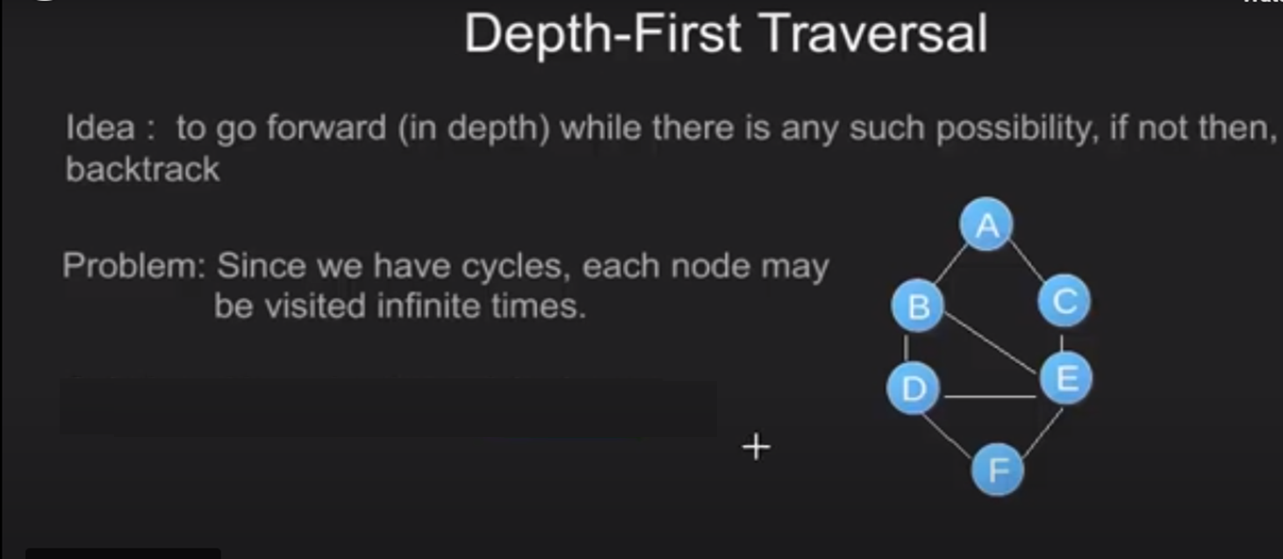
DFS

Slide 52
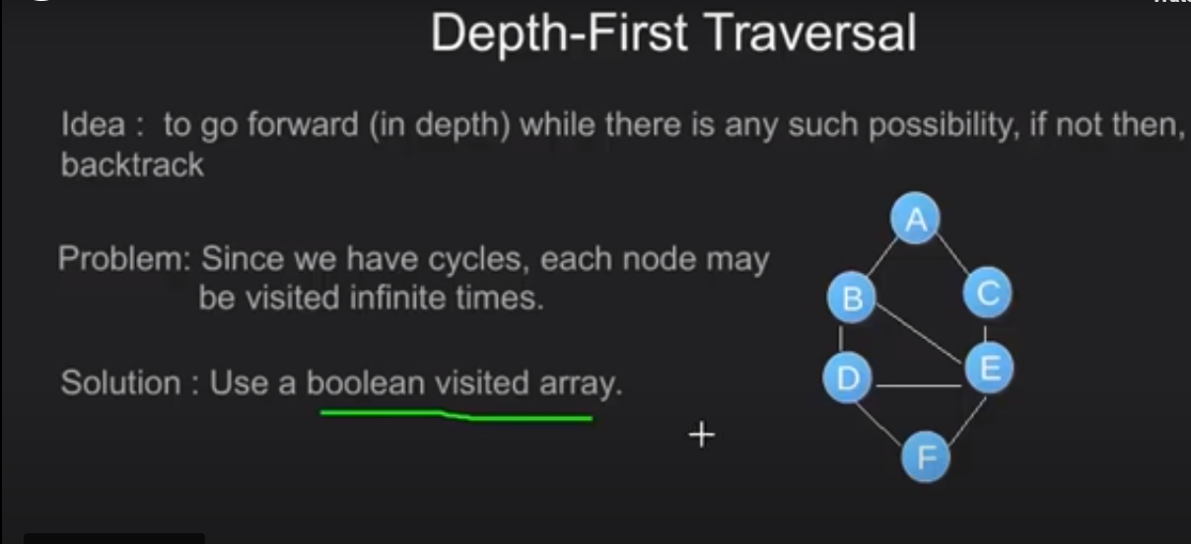
DFS

Slide 53
Applications of DFS
Finding Strongly Connected Components of a graph
Solving puzzles with only one solution, such as mazes.
Topological Sorting(Scheduling)
Path Finding
Cycle detection

Slide 54
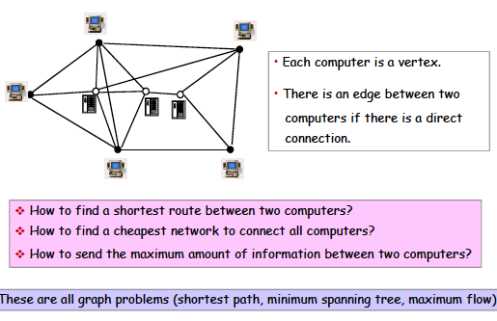
Problems in a computer network

Slide 55
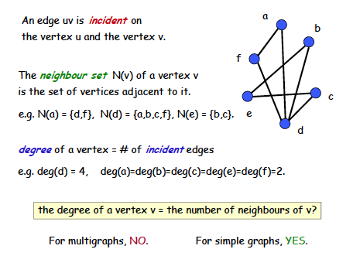
Vertex degree

Slide 56
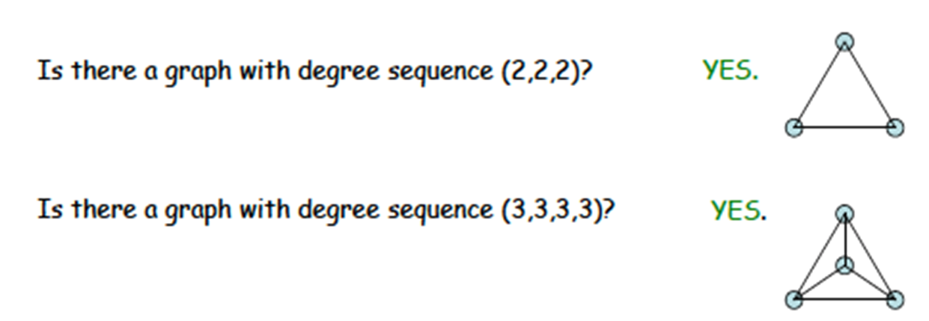

Slide 57
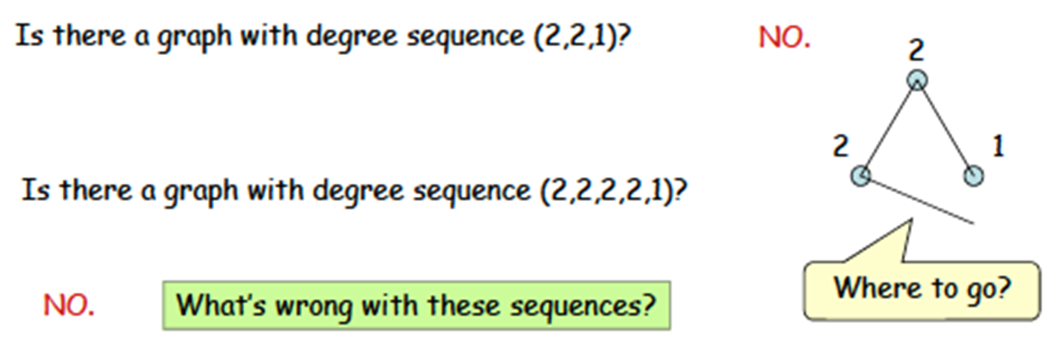
Degree sequence

Slide 58
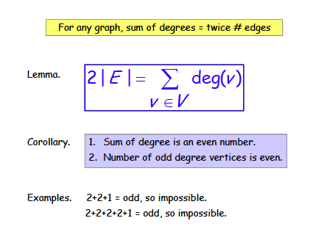
Handshaking theorem

Slide 59
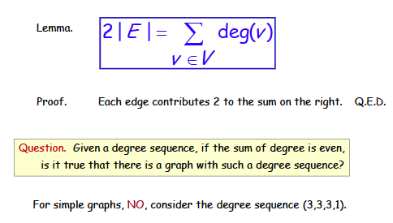
Handshaking theorem

Slide 60
Planar Graphs
These class notes are based on material from our textbook, Discrete Mathematics and Its Applications, 6th ed., by Kenneth H. Rosen, published by McGraw Hill, Boston, MA, 2006. They are intended for classroom use only and are not a substitute for reading the textbook.

Slide 61
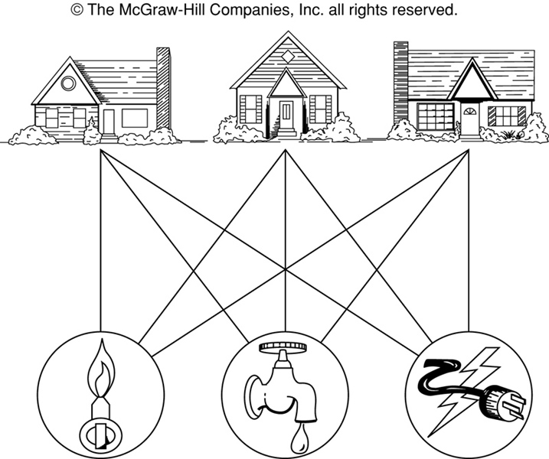
The House-and-Utilities Problem

Slide 62
Planar Graphs
Consider the previous slide. Is it possible to join the three houses to the three utilities in such a way that none of the connections cross?

Slide 63
Planar Graphs
Phrased another way, this question is equivalent to: Given the complete bipartite graph K_{3,3}, can K_{3,3} be drawn in the plane so that no two of its edges cross?
K_{3,3}

Slide 64
Planar Graphs
A graph is called planar if it can be drawn in the plane without any edges crossing.
A crossing of edges is the intersection of the lines or arcs representing them at a point other than their common endpoint.
Such a drawing is called a planar representation of the graph.

Slide 65
Example
A graph may be planar even if it is usually drawn with crossings, since it may be possible to draw it in another way without crossings.

Slide 66
Example
A graph may be planar even if it is usually drawn with crossings, since it may be possible to draw it in another way without crossings.

Slide 67
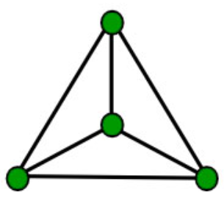
Example
A graph may be planar even if it is usually drawn with crossings, since it may be possible to draw it in another way without crossings.

Slide 68
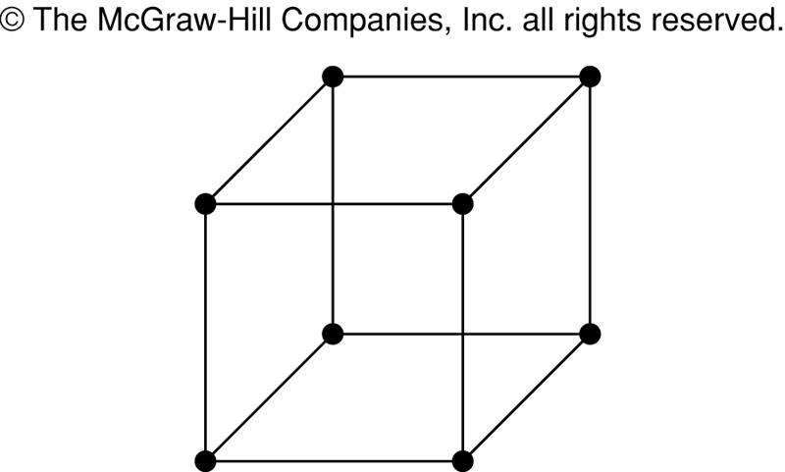
Example
A graph may be planar even if it represents a 3-dimensional object.
Example – Is the hypercube Q3 planar?

Slide 69
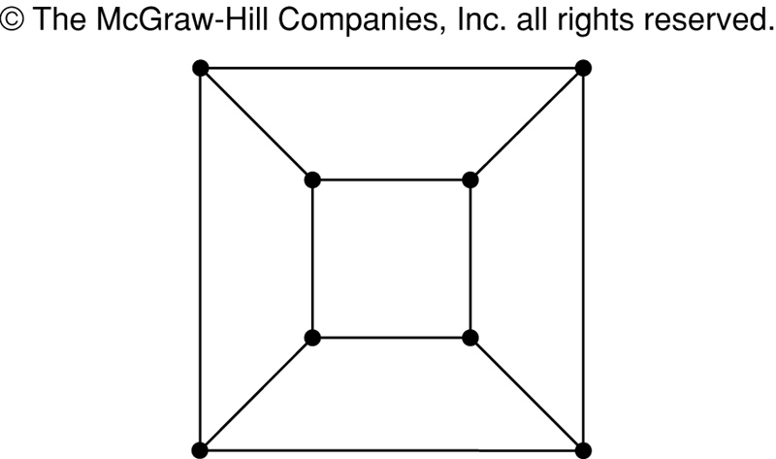
Example
A graph may be planar even if it represents a 3-dimensional object.

Slide 70
To show a graph is planar redraw it with none of its edges crossing.

Slide 71
To show a graph is planar redraw it with none of its edges crossing.
Notice that you can curve lives when you need to

Slide 72
Planar Graphs
We can prove that a particular graph is planar by showing how it can be drawn without any crossings.
However, not all graphs are planar.
It may be difficult to show that a graph is nonplanar. We would have to show that there is no way to draw the graph without any edges crossing.

Slide 73
Regions
Euler showed that all planar representations of a graph split the plane into the same number of regions, including an unbounded region.
R₄ R₃ R₂
R₁

Slide 74
Regions
Euler devised a formula for expressing the relationship between the number of vertices, edges, and regions of a planar graph.
These may help us determine if a graph can be planar or not.

Slide 75
Euler’s Formula
Let G be a connected planar simple graph with e edges and v vertices. Let r be the number of regions in a planar representation of G. Then r = e - v + 2.
R₄ R₃ R₂
R₁
# of edges, e = 6
# of vertices, v = 4
# of regions, r = e - v + 2 = 4

Slide 76
Euler’s Formula (Cont.)
Corollary 1: If G is a connected planar simple graph with e edges and v vertices where v ≥ 3, then e ≤ 3v - 6.
Is K₅ planar?
K₅

Slide 77
Euler’s Formula (Cont.)
K₅ has 5 vertices and 10 edges.
We see that v ≥ 3.
So, if K₅ is planar, it must be true that e ≤ 3v – 6.
3v – 6 = 3*5 – 6 = 15 – 6 = 9.
So e must be ≤ 9.
But e = 10.
So, K₅ is nonplanar.
K₅

Slide 78
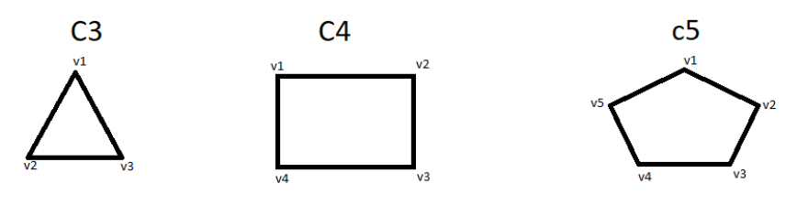
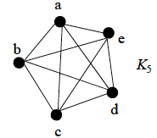
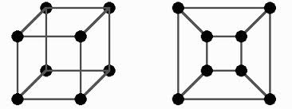



Types of graphs
Cycle graph
Complete graph:
All vertices are adjacent
The n-cube graph, n=3
Wheel graph
bipartite graph

Slide 79
Euler’s Formula (Cont.)
Corollary 2: If G is a connected planar simple graph, then G must have a vertex of degree not exceeding 5.
If G has one or two vertices, it is true;
thus, we assume that G has at least three vertices.
If the degree of each vertex were at least 6, then by Handshaking Theorem,
2e ≥ 6v, i.e., e ≥ 3v,
but this contradicts the inequality from
Corollary 1: 1 e ≤ 3v – 6.

Slide 80
Euler’s Formula (Cont.)
Corollary 3: If a connected planar simple graph has e edges and v vertices with v ≥ 3 and no circuits of length 3, then e ≤ 2v - 4.
Is K_{3,3} planar?

Slide 81
Euler’s Formula (Cont.)
K_{3,3} has 6 vertices and 9 edges.
Obviously, v ≥ 3 and there are no circuits of length 3.
If K_{3,3} were planar, then e ≤ 2v – 4 would have to be true.
2v – 4 = 2*6 – 4 = 8
So e must be ≤ 8.
But e = 9.
So K_{3,3} is nonplanar.
K_{3,3}

Slide 82
Planar Graph
How to verify that a graph is a planar graph? It should not depend
upon how you draw the graph.
Any graph that contains a K₅ or K_{3,3} as its sub-graph is not planar

Slide 83
Graph Coloring

Slide 84

Application: Exam scheduling
Why?

Slide 85
Graph Coloring
Let G be a graph, and C be a set of colors. Graph coloring finds an assignment of colors to the different nodes of G, so that no two adjacent nodes have the same color.
The problem becomes challenging when the |C| is small.
Chromatic number. The smallest number of colors needs to color a graph is called its chromatic number.

Slide 86
Graph Colouring
Graph Colouring Problem:
Given a graph, colour all the vertices so that
two adjacent vertices get different colours.
Objective: use minimum number of colours.
3-colourable

Slide 87
Optimal Colouring
Definition. min #colors for G is chromatic number, (G) and denoted by symbol kapa.
What graphs have chromatic number one?
when there are no edges…
What graphs have chromatic number 2?
What graphs have chromatic number larger than 2?
A path? A cycle? A triangle?

Slide 88
Simple Cycles

Slide 89
Complete Graphs

Slide 90
Wheels

Slide 91
Graph Coloring
The chromatic number of a tree is 2.

Slide 92
Trees
root
Pick any vertex as “root.”
if (unique) path from root is
even length:
odd length:
Can prove more formally using induction.

Slide 93
2-Colourable Graphs
When exactly is a graph 2-colourable?

Slide 94
2-Colourable Graphs
When exactly is a graph 2-colourable?
This is 2-colourable.
2 colourable: tree, even cycle, etc.
Not 2 colourable: triangle, odd cycle, etc.

Slide 95


Graph Coloring
What are the chromatic numbers of these two graphs?

Slide 96
Four color theorem
Theorem. Any planar graph can be colored using
at most four colors.
It all started with map coloring – bordering states or counties
must be colored with different colors. In 1852, an ex-student
of De Morgan, Francis Guthrie, noticed that the counties in
England could be colored using four colors so that no adjacent
counties were assigned the same color. On this evidence, he
conjectured the four-color theorem. It took nearly 124 years
to find a proof. It was presented by Andrew Appel and
Wolfgang Haken.

Slide 97
What is the chromatic number of Kn ?
What is the chromatic number of Cn ?
What is the chromatic number of Km,n ?

Slide 98
A problem with train tracks and interval graphs

Slide 99

Real World Problem
As there are very busy cities in this world they may face a problem with train tracks. In some cities we have very few tracks and many trains in which their will be a moving trains one after the other from both sides. So , their shouldn’t be any colliding they must have some perception before itself. This may help in avoiding train trafficking and train accidents.

Slide 100
Proposed Solution
This can be solved by allotting tracks to trains by scheduling trains with time intervals without time conflicts with other train.
Trains which come on same time should assign different track in one station, this avoid waiting time for other trains.
A proper solution can be given for some tracks by taking set of trains as vertices and time conflict as edges.
We allot train timings in different tracks in stations by using graph theory.

Slide 101

Interval Graph
A graph G is an interval graph if we can represent the intervals on a number line such that two vertices are joined by an edge if and only if their corresponding intervals overlap.

Slide 102
SPECIAL PROPERTIES
Graph coloring:
Given a graph, color all the vertices so that two adjacent vertices get different colors.
Complete Graphs:
Every vertices should have a edge between each other vertices.
Chromatic number:
The chromatic number of a graph is the smallest number of colors needed to color the vertices, so that no two adjacent vertices share the same color the smallest value of possible to obtain a k-coloring.
Umbrella - free ordering :
An umbrella-free representation of a graph G is a concatenation of all its connected component.

Slide 103
Interpreting graph solution to real life problem
This problem can be solved by using graph coloring concept by coloring the vertices by using chromatic number concept to color vertices with minimum number of colors. Colors got by edges are the tracks for which we are allocating tracks for trains.

Slide 104
Problem Solution
Let’s consider seven trains and assign them with alphabets, they are A,B,C,D,E,F,G.
Firstly we can allot some timings to the train in random time intervals.
Train : Time duration
A : 1-3
B : 6-8
C : 2-5
D : 10-12
E : 2-7
F : 6-11
G : 4-9

Slide 105
Problem Solution
Keep this time intervals in an interval graph where we may see time conflicts between the train timings.
g
f
e
d
c
b
a
0 1 2 3 4 5 6 7 8 9 10 11 12
We can see in Black line 4 trains come to same station at different tracks at same time.

Slide 106
Graph Coloring
Construct a graph by using interval graph and arrange the vertices and edges. By using Graph coloring we have colored following vertices and got different colors as follows.
b
a
d
c
e
f
g

Slide 107
Graph Coloring
By using chromatic number we have colored the vertices and got minimum K colors.
4 colors (Purple , Yellow, blue , Green)
Colors which we got by edges are the tracks which we are Allocating for trains.
Finally the allocation of tracks by using coloring graphs results to:
Tracks:
1 2 3 4
Purple Yellow Blue Green
A,G,D C,F B E
Suddenly if any new train would like to come into same station then we can allot any track by considering(check the time intervals of trains in all tracks) that which is free at that time.

Slide 108
SUMMARY
Graph coloring is useful in modeling problems in real life.
It is an important problem in graph theory.
We can use this in many applications where we find time conflicts and can solve them by allocating time intervals.

